Slide 1

Plant diseases identification
using Computer Vision
Vasileios Vitzilaios, MTN2201

Slide 2
Table of Contents
Introduction
Dataset
Data Preprocessing
The Model
Training
Results & Findings
Challenges & Solutions
Future Improvements & Applications
Conclusion
Questions & Discussion

Slide 3
Introduction
Objective: Detect and classify diseases in plant leaves using computer vision techniques.
Importance: Early disease detection can lead to timely interventions, ensuring healthier plants and improved yields.
Approach:
Find an appropriate dataset
Data exploration & preprocess
Model construction & configuration
Train & test the model
Model fine tuning
Extract results

Slide 4
Dataset
Dataset source: New Plant Diseases Dataset from Kaggle
Dataset size: >70.000 images
(Samples of 500 images per class were used for faster results).
No. of classes: 38
No. of unique plants: 14
No. of unique diseases: 20

Slide 5
Data Preprocessing
Data Augmentation: Techniques (including resize, flip and crop) were used to increase the diversity of the training set, making the model more robust.
Train, Validation, and Test Split: Percentage breakdown (e.g., 80% train, 20% validation).
Data Loaders: Efficient batching and loading of dataset for training and evaluation.

Slide 6
The Model
Base Model: ResNet
Simplified Modifications: Simplifications were made including model’s depth, number of residual blocks, filter rate increase etc.
Why ResNet9: A concise and efficient architecture for applications where computational resources are limited or where the dataset might not be extensive enough

Slide 7
The Model
Conv2D Layer: Captures spatial features using a 3x3 kernel.
BatchNorm2D: Improves stability and convergence during training.
ReLU Activation: Non-linear transformation for learned features.
Optional Max Pooling: Downsamples the spatial dimensions by a factor of 4.

Slide 8
The Model
Initial Layers:
conv1: 64 filters, no pooling.
conv2: 128 filters, with pooling.
Residual Block 1:
Two sequential ConvBlocks.
Feature maps from conv2 are added to the output to introduce the residual connection.
Mid Layers:
conv3: 256 filters, with pooling.
conv4: 512 filters, with pooling.
Residual Block 2:
Two sequential ConvBlocks.
Feature maps from conv4 are added to the output, creating another residual connection.

Slide 9
The Model
Adaptive Average Pooling: Reduces spatial dimensions to 1x1.
Flatten: Converts 2D feature maps to a 1D vector.
Fully Connected Layer: Maps the features to the required number of classes.

Slide 10
Training
Loss Function: Cross Entropy Loss function.
Quantifies the difference between the predicted probabilities and the actual class labels.
Penalizes predictions that are confidently incorrect more severely than predictions that are less confident.
Good for classification tasks.
Optimizer: ADAM Optimizer.
Computes adaptive learning rates for each parameter
Faster convergence and reduced sensitivity to hyperparameters
No. Training Epochs: 10

Slide 11
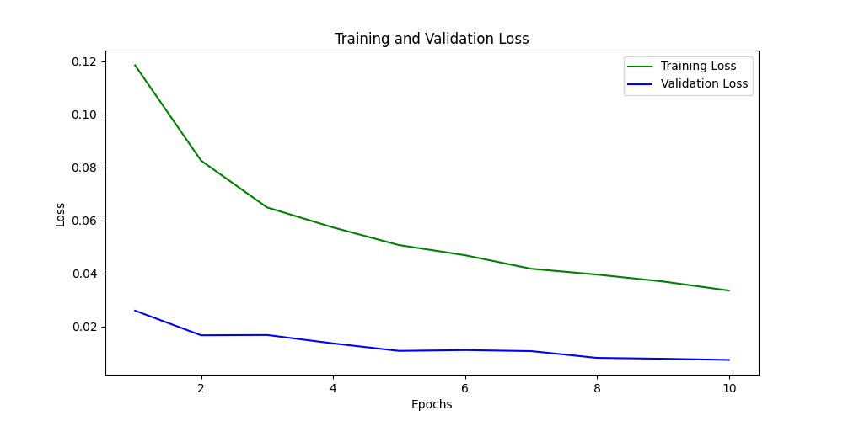
Results & Findings

Slide 12
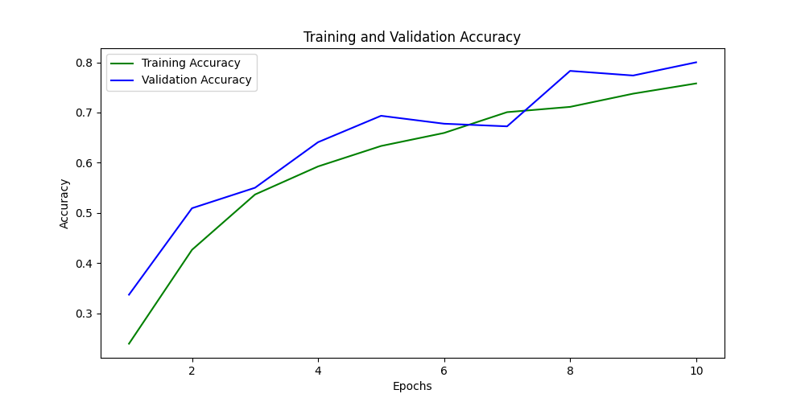
Results & Findings

Slide 13
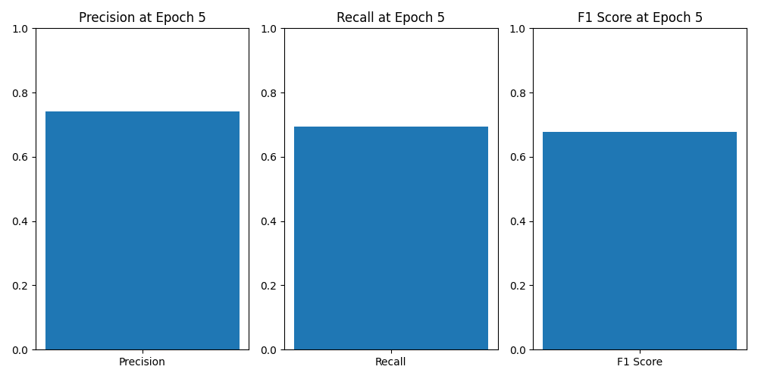
Results & Findings

Slide 14
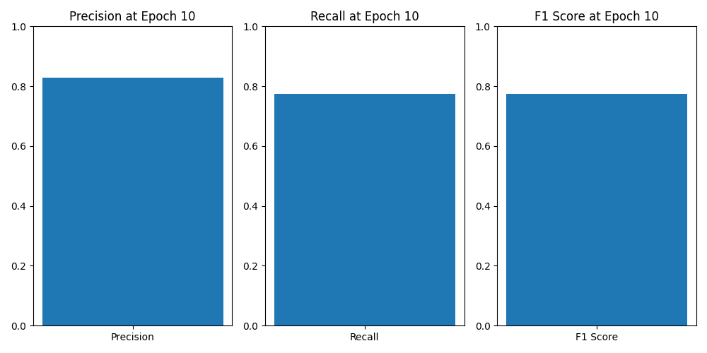
Results & Findings

Slide 15
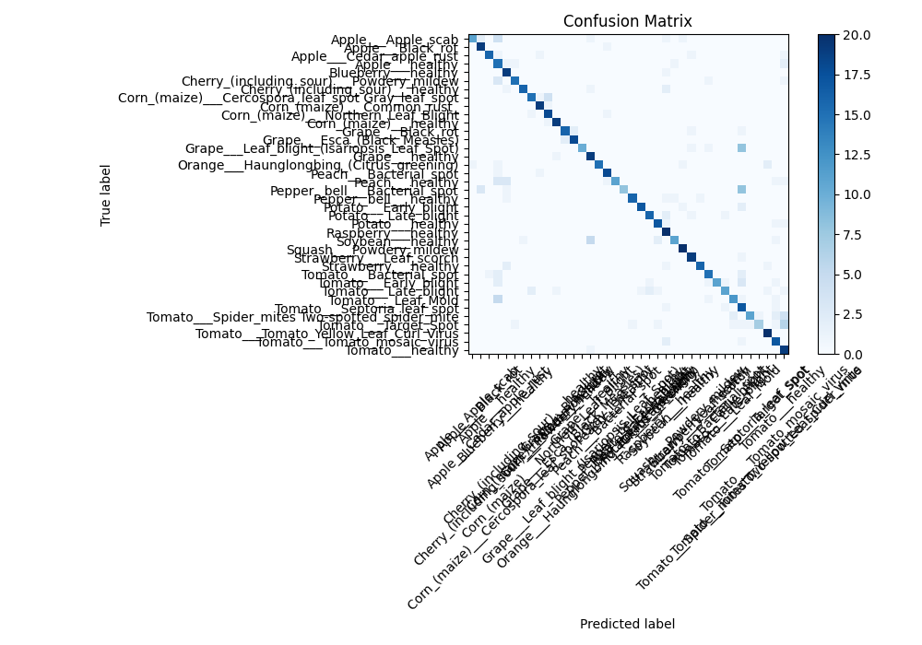
Results & Findings

Slide 16
Challenges & Solutions
Model selection & architecture:
Extensive study of available literature.
simplified version of the more complex ResNet architectures.
Training process total duration:
Simplified version of ResNet to reduce training time without sacrificing too much accuracy.
Data augmentation to artificially increase the size and variability, allowing for better generalization with fewer epochs.
Adam optimizer which converges faster.
Scalability:
Used modular code structure.
Architecture can be easily extended.
Periodically fine-tuning the model on newer datasets.

Slide 17
Future Improvements & Applications
Data Collection: Additional data that can be beneficial.
Model Enhancements: Potential upgrades or changes to the architecture.
Deployment: Deployment scenarios (e.g., mobile app for farmers, agronomy institutions etc).

Slide 18
Conclusion
Successfully developed a deep learning model to identify plant diseases with high accuracy.
Leveraged the ResNet9 architecture, striking a balance between performance and computational efficiency.
Overcame challenges related to training duration and scalability.
This project paves the way for real-time applications in agriculture, ensuring healthier crops and better yields.

Slide 19
Questions?

